Slide 1

Window Cover
Honour team 3:
Timothy van der Steenhoven
Saskia van der Velden
Emanuel Bakare

Slide 2
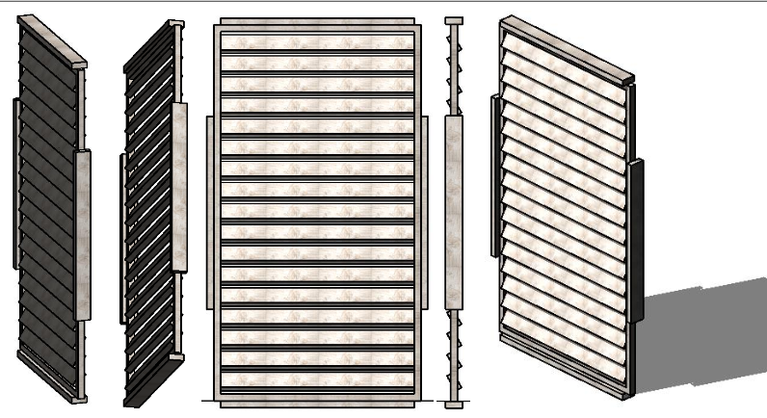
Window cover
Panel doors
Window cover.
keep the most warmth and sunlight out of theroom/space.
See point 3.
On the outside of the window.
Everyone with a house with windows can use it.
Everyone with a house with windows who want te keep the warmth and sunlight out.
A company that saw wooden panels and make wooden furniture.

